Slide 1

The Sudoku Solver
Richard Tabaka

Slide 2
Sudoku:
Sudoku puzzles are solved by finding a number that can be placed in an empty position without breaking 3 rules:
1: The row it’s in can’t contain that number
2: The column can’t contain that number
3: The grid can’t contain that number
 | 1 | 2 | 3 | 4 | 5 | 6 | 7 | 8 | 9
1 | 1 | 2 | 3 |  |  |  |  |  | 2
2 | 4 | 5 | 6 |  |  |  |  |  | 3
3 | 7 | 8 | 9 |  |  |  |  |  | 4
4 |  |  |  |  |  |  |  |  | 5
5 |  |  |  |  |  |  |  |  | 6
6 | 8 | 9 | 1 | 2 | 3 | 4 | 5 | 6 | 7
7 |  |  |  |  |  |  |  |  | 8
8 |  |  |  |  |  |  |  |  | 9
9 |  |  |  |  |  |  |  |  | 1

Slide 3

Purpose:
The program is designed to:
Verify the puzzle is valid
Solve complex sudoku puzzles
Provide hints to assist a user
Create a text file containing the solution
In order to do so, it:
Reads a file, converting it to usable data
Solves the puzzle
Returns hints or a full solution

Slide 4
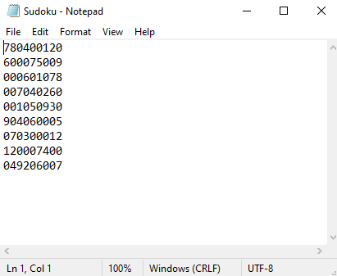
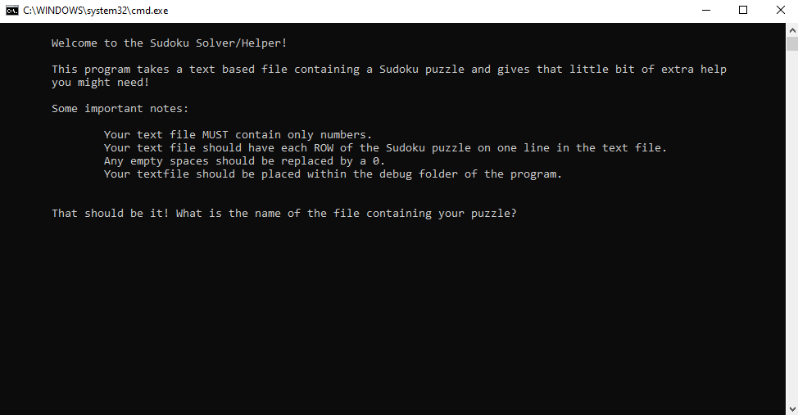
Input:
The program uses StreamReader to pull a puzzle from a file input by the user
Each line in the file is added to a string array
The format of the file is:
9 columns, 9 rows, no empty spaces or characters that aren’t 0-9
Empty squares represented by 0’s
Text file of some form

Slide 5
Method:
First, the program finds an empty position
Then, it plugs in 1 and tests. If 1 fails, 2
When it finds a number that works, it moves to the next empty spot
It carries on filling until it can’t, then works its way back and forth
It does this using recursion
 | 1 | 2 | 3 | 4 | 5 | 6 | 7 | 8 | 9
1 | 1 | 2 | 3 | 4 |  |  |  |  | 2
2 | 4 | 5 | 6 |  |  |  |  |  | 3
3 | 7 | 8 | 9 |  |  |  |  |  | 4
4 |  |  |  |  |  |  |  |  | 5
5 |  |  |  |  |  |  |  |  | 6
6 | 8 | 9 | 1 | 2 | 3 | 4 | 5 | 6 | 7
7 |  |  |  |  |  |  |  |  | 8
8 |  |  |  |  |  |  |  |  | 9
9 |  |  |  |  |  |  |  |  | 1

Slide 6
Tests:
 | 0 | 1 | 2 | 3 | 4 | 5 | 6 | 7 | 8
0
1
2
3
4
5 |  |  |  |  | X
6
7
8
Row:
Iterates over every number within the row, verifying that it doesn’t exist within the row already
Column:
Iterates over every number within the row, verifying that it doesn’t exist within the row already
Columns aren’t actually stored, they are accessed by using the position on which the number was inserted
Box:
Iterates over numbers within its box, verifying that it doesn’t exist within the box already
Boxes are also calculated as it goes
Does do by using integer division
Row 4, Column 5:
4/3 = 1, 5/3=1: 1,1
(0,0) | (1,0) | (2,0)
(0,1) | X | (2,1)
(0,2) | (1,2) | (2,2)

Slide 7
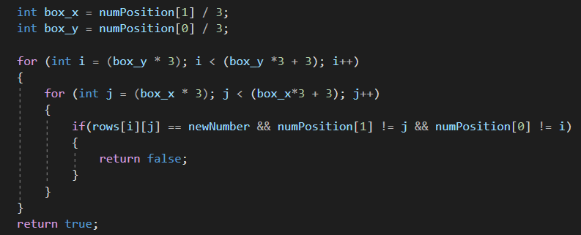
Accessing the Data
Each row of the puzzle is stored in one string within a string array
String[] Rows:
Rows[0] = “780400120”
Rows[0][0] = ‘7’
Columns:
String[0-8][0]
Boxes:
Relies on a nested for loop
Box X = Column/3 – > Column/3 + 3
Box Y = Row/3 -> Row/3 + 3

Slide 8
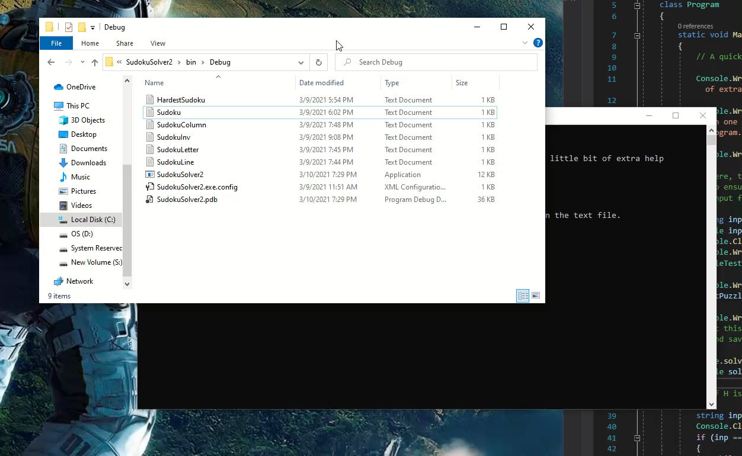
Hints:
Prompts the user for a coordinate
Returns the corresponding correct answer
Solutions:
The program solves the puzzle right off the bat but doesn’t log it to the console unless told to do so
The solution is saved in a file in the debug folder

